Slide 1

Department of Computer Science and Engineering TEXT SUMMARIZATIONMETHOD Date: 28 May 2021
S.VARSHA : 17WH1A0512
K.PRASEEDA: 17WH1A0533
D.KEERTHANA:17WH1A0555
Internal Guide : Mr . K .Rajesh
Designation: Assistant Professor

Slide 2


Abstract
Why Should I Study this course?
Examples
BVRIT HYDERABAD College of Engineering for Women
In this new era, where tremendous information is available on the internet, it is most important to provide the improved mechanism to extract the information quickly and most efficiently . It is very difficult for human beings to manually extract the summary of a large documents of text .Text summarization has become very essential to gain just the right amount of information from huge texts. Mostly, the methods described and discuss in this is produce Abstractive (ABS) or Extractive (EXT) summaries of text documents and about the structured based and semantic based approaches for summarization of the text documents.

Slide 3
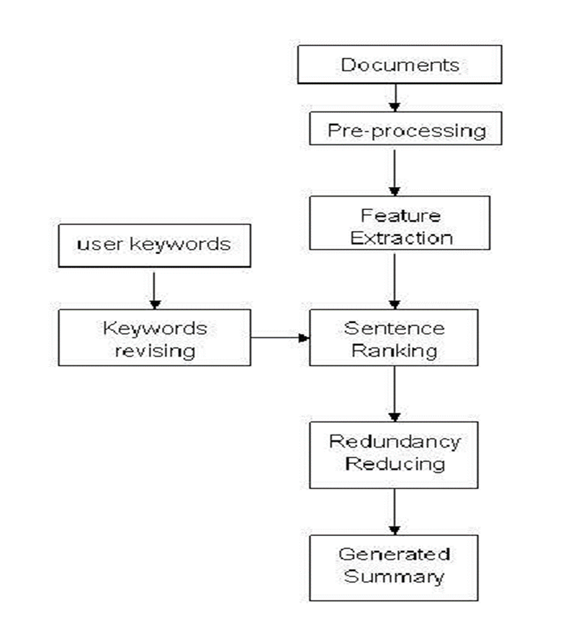
Architecture
Why Should I Study this course?
Examples

Slide 4

Technology Stack
Why Should I Study this course?
Examples
BVRIT HYDERABAD College of Engineering for Women
Machine learning using Python
Libraries Used :
Pandas
NumPy
Gensim
SpaCY
NLTK
Sumy LexRank

Slide 5
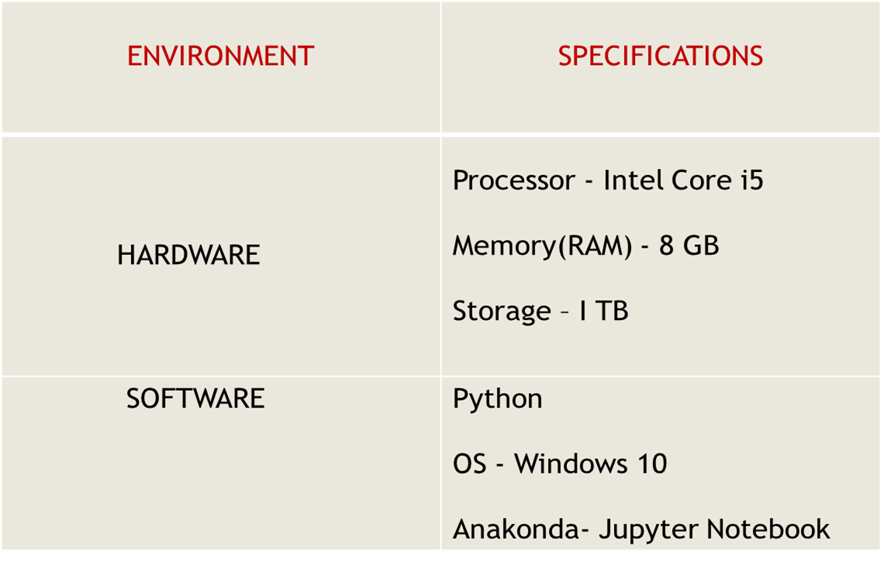
System Requirements
Why Should I Study this course?
Examples
BVRIT HYDERABAD College of Engineering for Women
,PyCharm

Slide 6
Algorithms
Why Should I Study this course?
Examples
BVRIT HYDERABAD College of Engineering for Women
Gensim
SpaCY
NLTK
Sumy LexRank

Slide 7


Slide 8
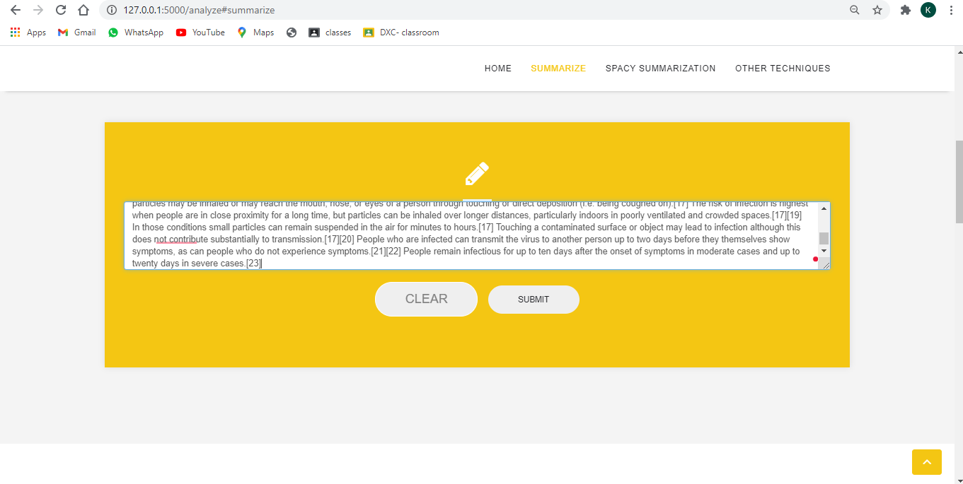
Why Should I Study this course?
Examples
BVRIT HYDERABAD College of Engineering for Women

Slide 9
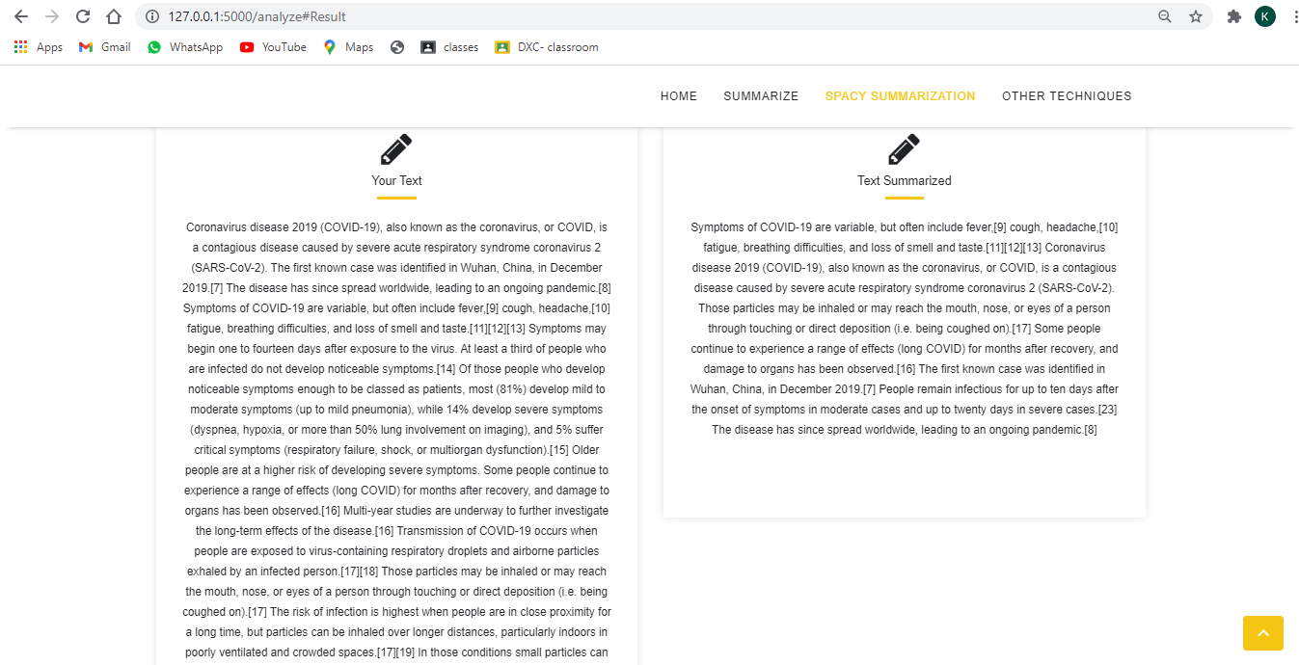
Why Should I Study this course?
Examples
BVRIT HYDERABAD College of Engineering for Women

Slide 10
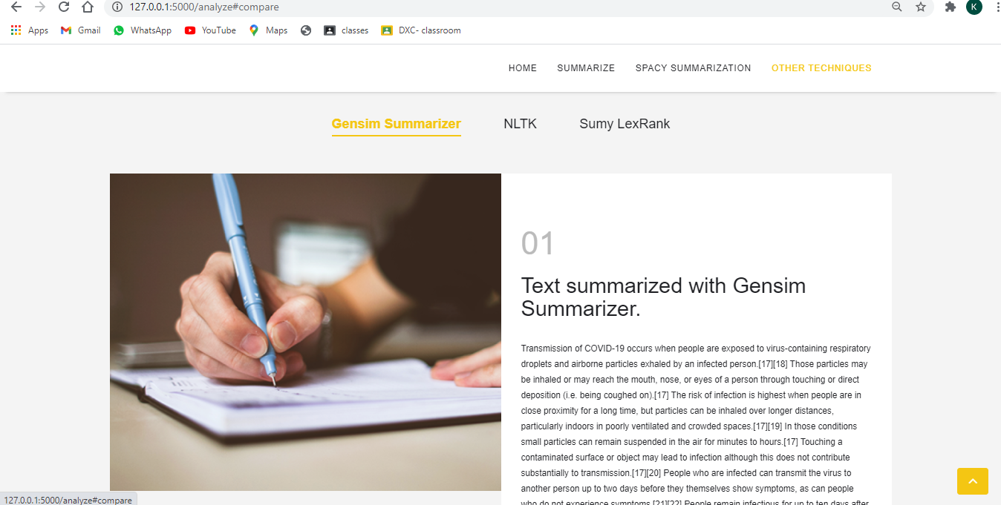


Slide 11
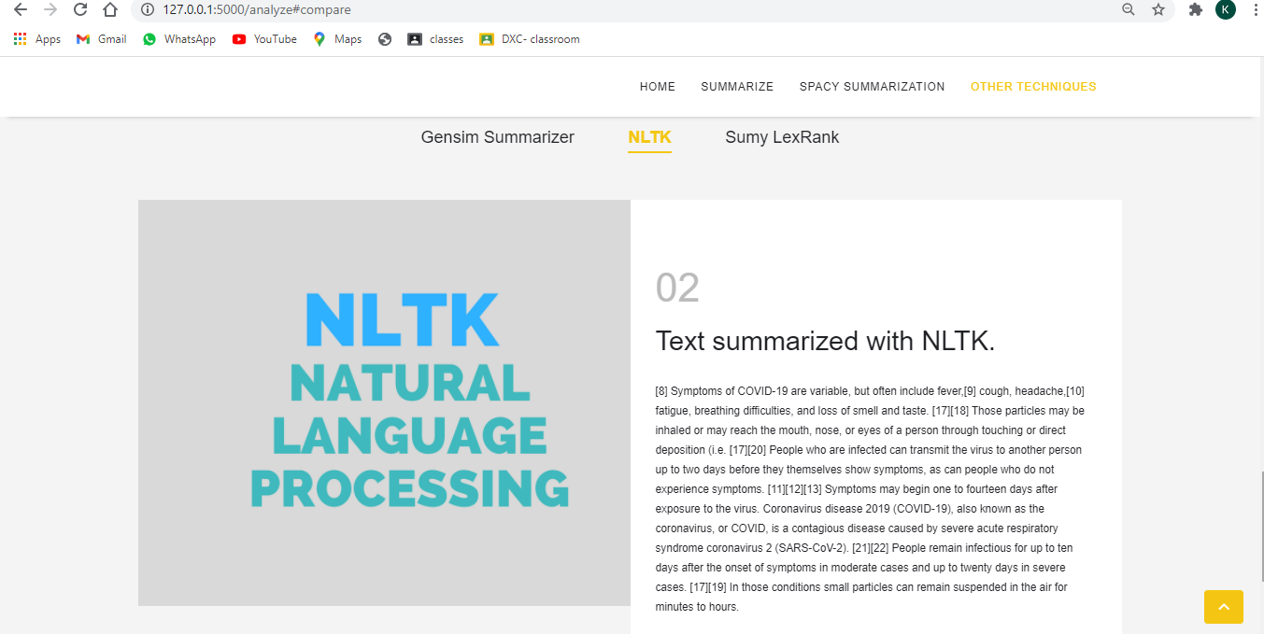

Slide 12
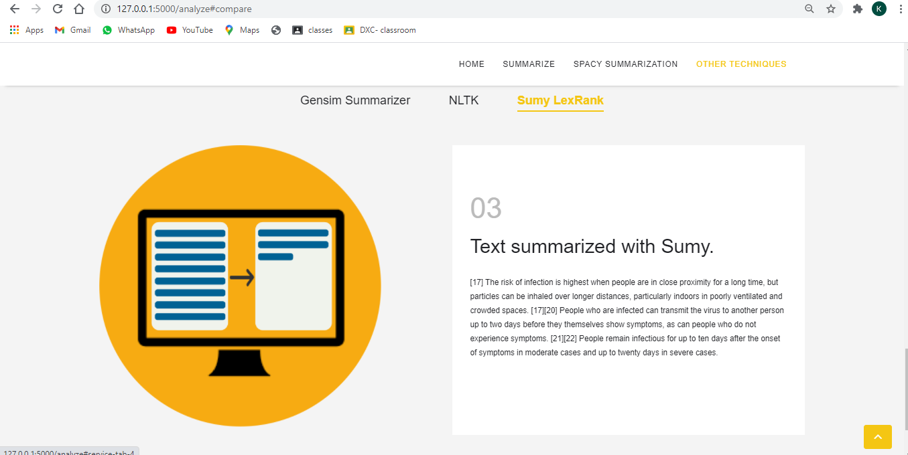

Slide 13
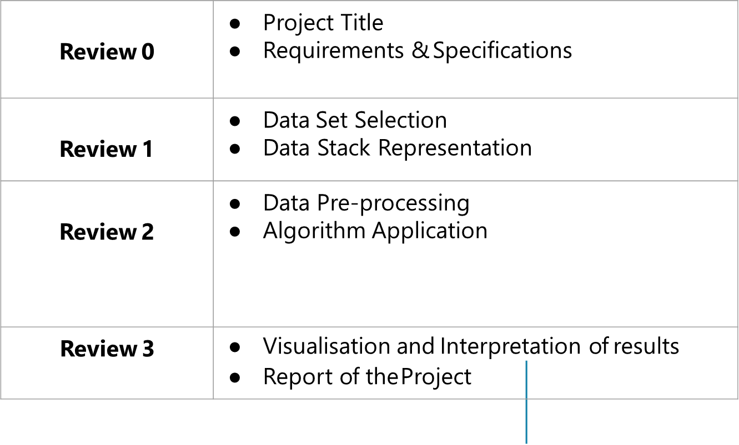
Timeline
Why Should I Study this course?
Examples
BVRIT HYDERABAD College of Engineering for Women

Slide 14
References
Why Should I Study this course?
Examples
BVRIT HYDERABAD College of Engineering for Women
https://www.irjet.net/archives/V7/i4/IRJET-V7I4647.pdf
https://www.researchgate.net/publication/317420253_A_survey_on_extractive_text_summarization
https://towardsdatascience.com/a-quick-introduction-to-text-summarization-in-machine-learning-3d27ccf18a9f
https://www.aclweb.org/anthology/2020.acl-main.120.pdf

Slide 15
Thank you

